Slide 1
Keras

Slide 2
About Keras
Keras is a high-level library that allows the use of TensorFlow as a backend deep learning library
Now Keras is included in TensorFlow Core as module tf.keras
Offers a consistent and simple API Modularity to allow the representation of various elements as pluggable modules
Ease of extensibility to add new modules as classes and functions
Python-native for both code and model configuration
Out-of-the-box common network architectures that support CNN, RNN, or a combination of both

Slide 3
Keras – Neural Networks
Neural network models in Keras are defined as the graph of layers.
The models in Keras can be created using the sequential or the functional APIs.
Sequential API is an easy to use as we can build simple to deep neural networks easily using well defined layers
The functional API makes it easier to build the complex models that have multiple inputs, multiple outputs and shared layers. Reserved for experts

Slide 4
Keras – Sequential API
Neural network models in Keras are defined as the graph of layers.
The models in Keras can be created using the sequential or the functional APIs.
Sequential API is an easy to use as we can build simple to deep neural networks easily using well defined layers
The functional API makes it easier to build the complex models that have multiple inputs, multiple outputs and shared layers. Reserved for experts

Slide 5
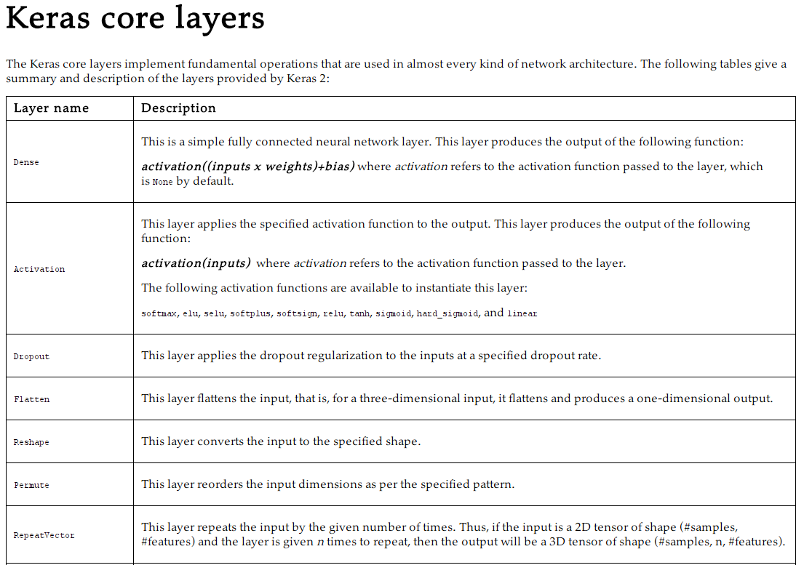

Slide 6
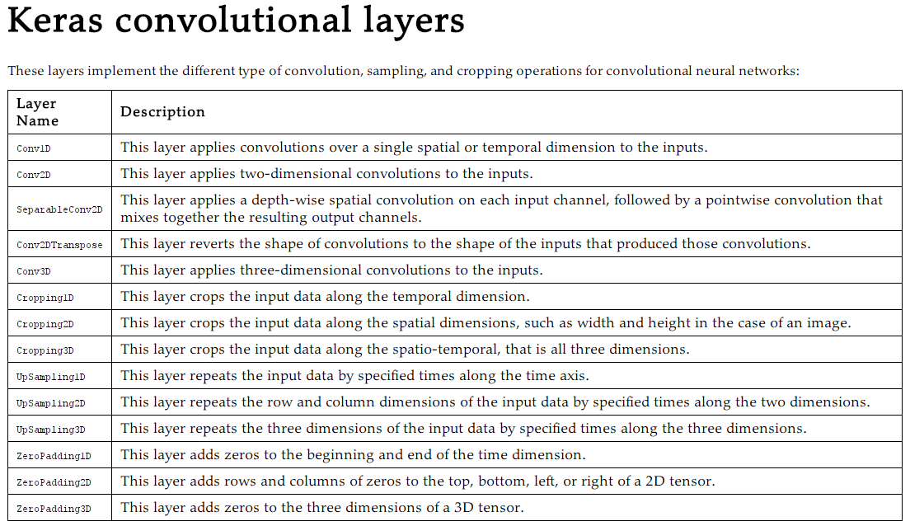

Slide 7
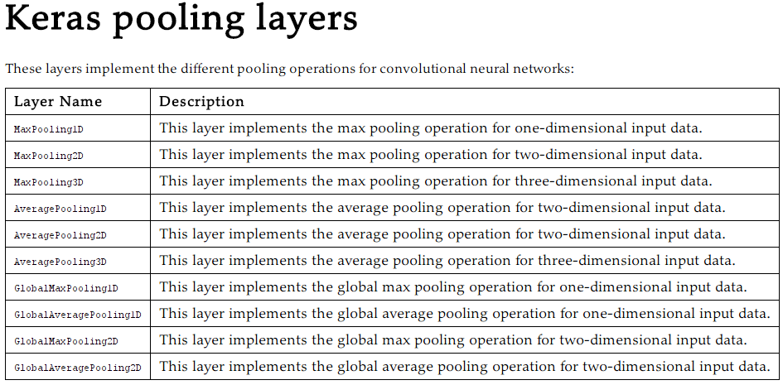

Slide 8
Keras – Neural Networks
create the empty model with the following code: model = Sequential()
Next add the layers to this model
In the sequential API, create layers by instantiating an object of one of the layer types The created layers are then added to the model using the model.add() function
As an example, we will create a model and then add two layers to it:
model = Sequential()
model.add( Dense( 10, input_shape =( 256,))
model.add( Activation(' tanh’))
model.add( Dense( 10))
model.add( Activation(' softmax'))

Slide 9
Keras – Neural Networks
model built in the previous sections needs to be compiled with the model.compile() method before it can be used for training and prediction
The compile method takes three arguments:
optimizer: specify your own function or one of the functions provided by Keras.
This function is used to update the parameters in the optimization iterations.
Keras offers the following built-in optimizer functions: SGD RMSprop Adagrad Adadelta Adam Adamax Nadam
loss: specify your own loss function or use one of the provided loss functions
The optimizer function optimizes the parameters so that the output of this loss function is minimized.
Keras provides the following loss functions: mean_squared_error mean_absolute_error mean_absolute_pecentage_error mean_squared_logarithmic_error squared_hinge hinge categorical_hinge sparse_categorical_crossentropy binary_crossentropy poisson cosine proximity

Slide 10
Keras – Neural Networks
The compile method takes three arguments (Contd…):
metrics: list of metrics that need to be collected while training the model. All the loss functions also work as the metric function.

Slide 11
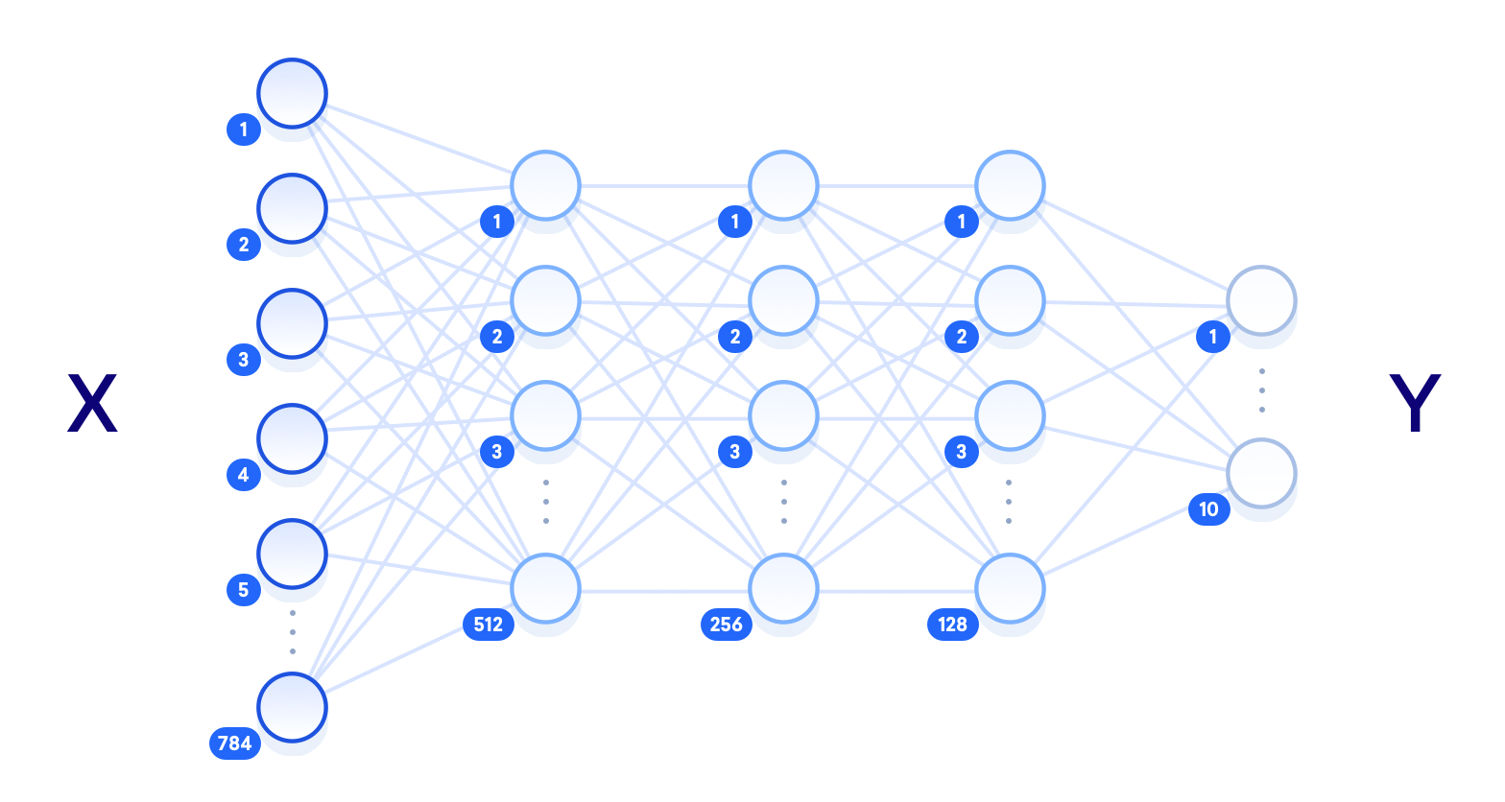
Deep neural network in TF
Class Work - Implement this in Keras

Slide 12
Keras – DNN - Mnist dataset - Walkthru
import keras
from keras.datasets import mnist
from keras.models import Sequential
from keras.layers import Dense, Dropout
from keras.optimizers import SGD
from keras import utils
import numpy as np
# define some hyper parameters
batch_size = 100
n_inputs = 784
n_classes = 10
n_epochs = 10
# get the data
(x_train, y_train), (x_test, y_test) = mnist.load_data() # reshape the two dimensional 28 x 28 pixels # sized images into a single vector of 784 pixels
x_train = x_train.reshape( 60000, n_inputs)
x_test = x_test.reshape( 10000, n_inputs)
# convert the input values to float32
x_train = x_train.astype( np.float32)
x_test = x_test.astype( np.float32)
# normalize the values of image vectors to fit under 1
x_train /= 255
x_test /= 255
# convert output data into one hot encoded format
y_train = utils.to_categorical( y_train, n_classes)
y_test = utils.to_categorical( y_test, n_classes)

Slide 13
Keras – DNN - Mnist dataset - Walkthru (Contd…)
# build a sequential model
model = Sequential() # the first layer has to specify the dimensions of the input vector
model.add( Dense( units = 128, activation ='sigmoid', input_shape =( n_inputs,))) # add dropout layer for preventing overfitting
model.add( Dropout( 0.1))
model.add( Dense( units = 128, activation ='sigmoid'))
model.add( Dropout( 0.1)) # output layer can only have the neurons equal to the number of outputs
model.add( Dense( units = n_classes, activation ='softmax')) # print the summary of our model
model.summary()
# compile the model
model.compile( loss ='categorical_crossentropy', optimizer = SGD(), metrics =['accuracy'])
# train the model
model.fit( x_train, y_train, batch_size = batch_size, epochs = n_epochs)
# evaluate the model and print the accuracy score
scores = model.evaluate( x_test, y_test)
print('\ n loss:', scores[ 0])
print('\ n accuracy:', scores[ 1])

Slide 14
Thank You

